Slide 1
Storyboard – Dangerous Goods Acceptance
CXA

Slide 2
Objective
The objective of the game will be to swiftly and accurately identify if DG shipment can be accepted or not.
The Player will need to identify every reason if the shipment needs to be rejected based on the documents (AWB and DGD) and package the Player receives.

Slide 3
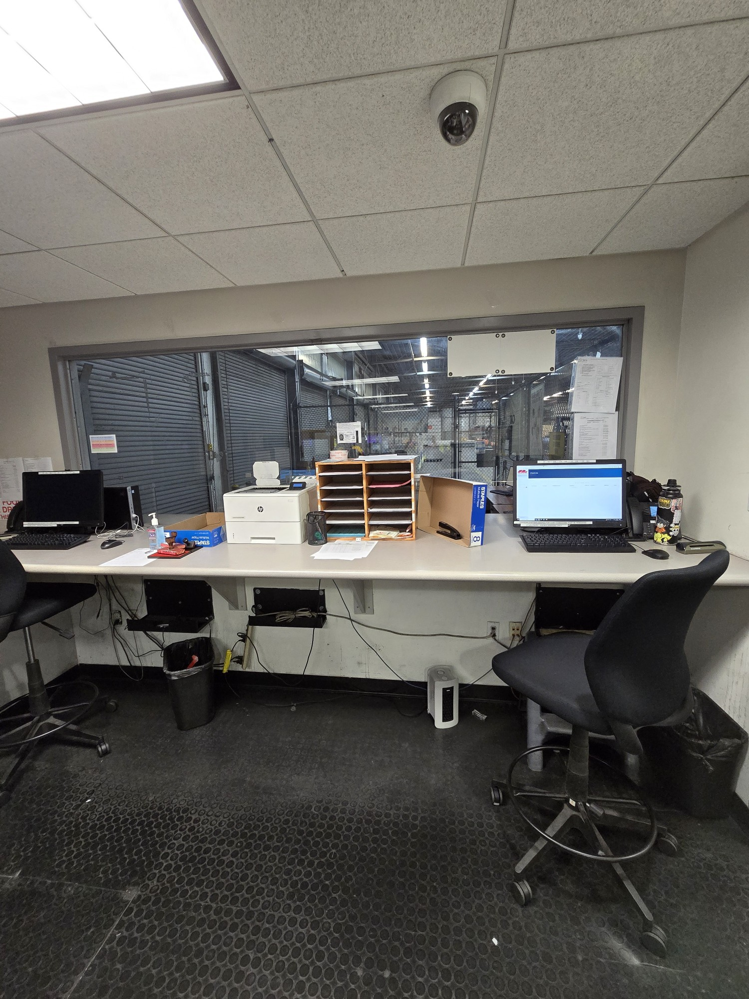
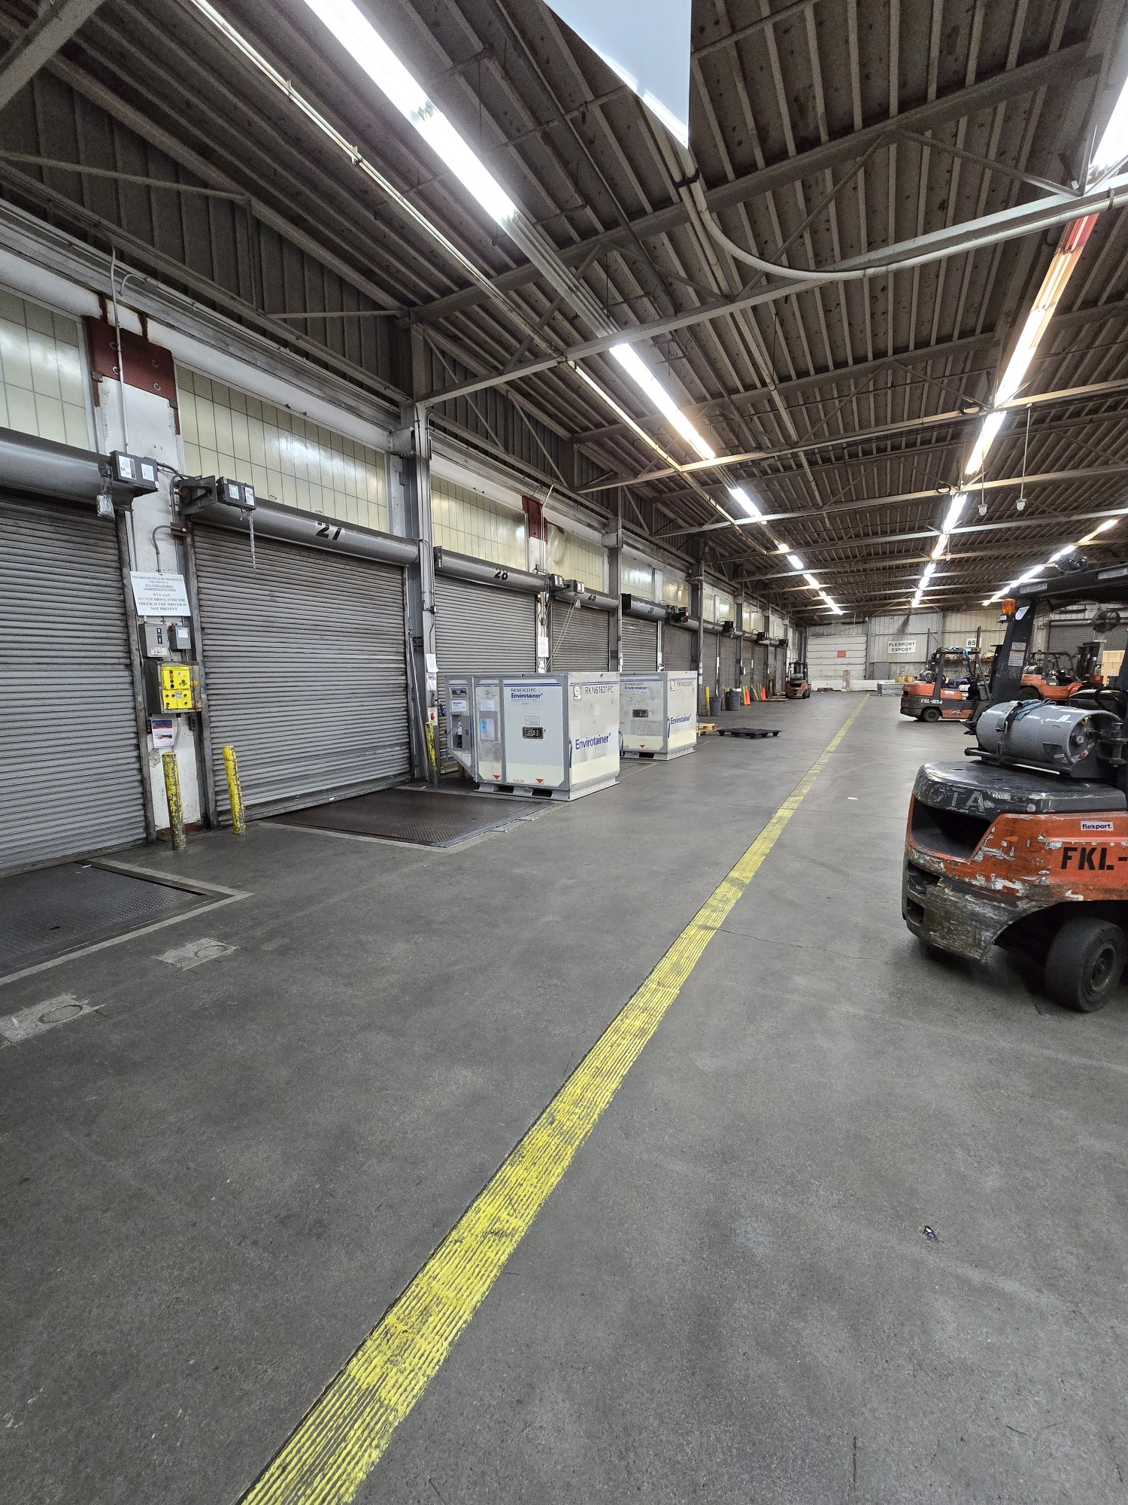
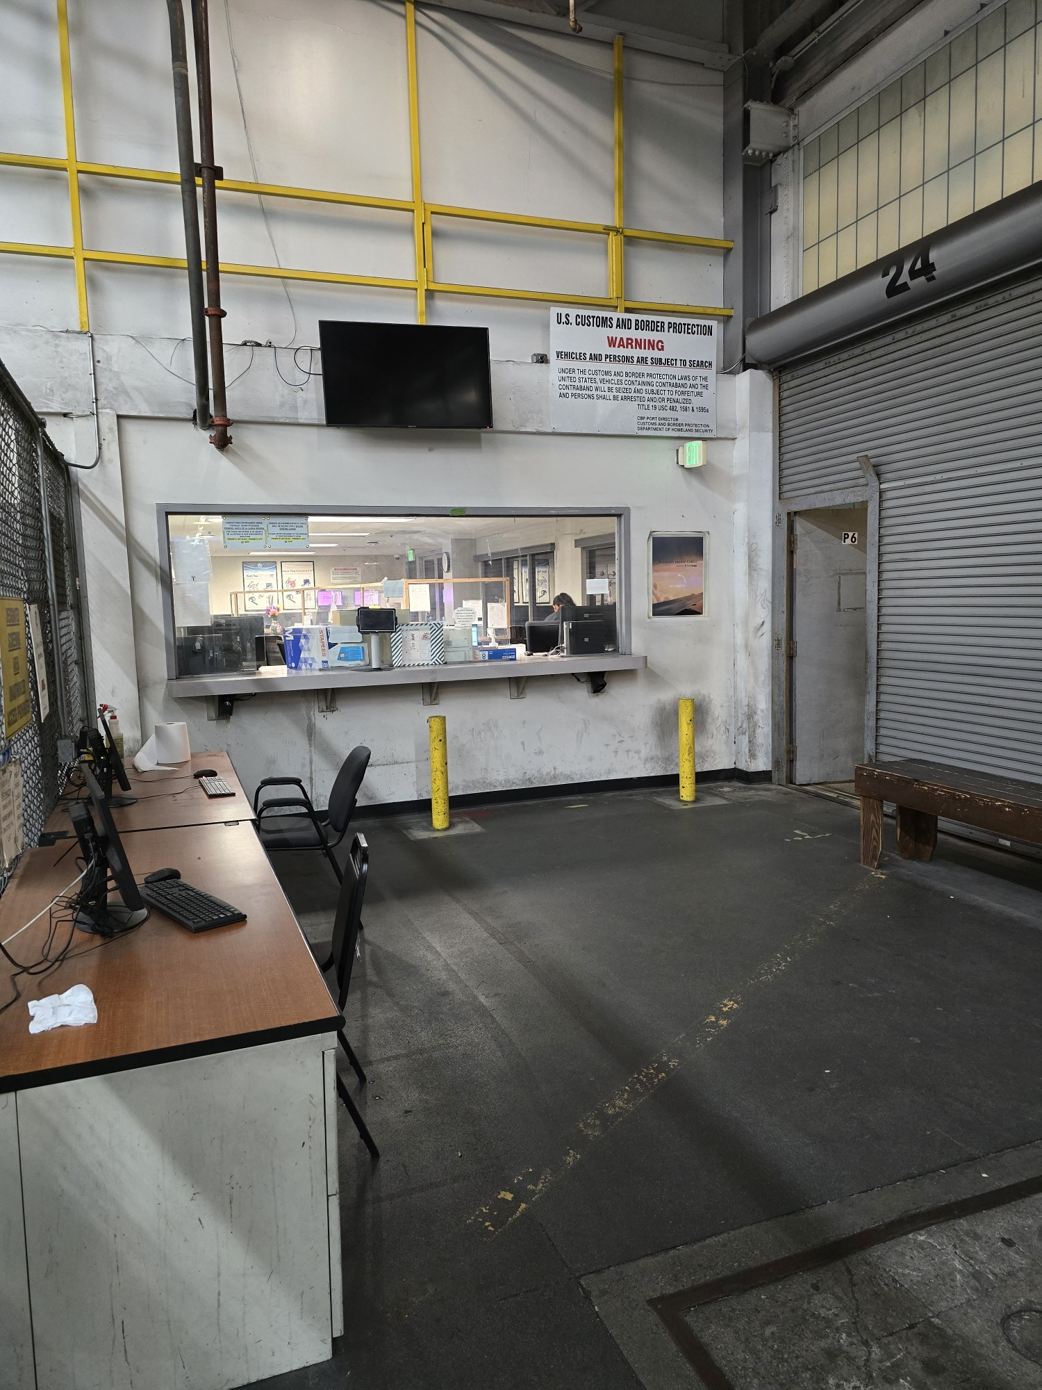
Game Structure / Background
The game will have 3 locations to recreate acceptance counter, warehouse, and waiting area for truck drivers.

Slide 4
DashBoard
The overlay will have various display. Some examples can be:
DGR 4.2 Button (to popup the 4.2 information)
AWB Button (to popup AWB document)
DGD Button (to popup DGD document)
Package Button (to show the package)
Hint Button (to popup any hint on where the shipment might have issue)
Timer (to show how long it took for player to complete the game)
Scoreboard (to show real-time scoring)
Truck Driver Queue (to show how many truck drivers are waiting)

Slide 5
Gameplay
There will be 2 different play modes within the game.
Standard mode
Beginner level
Intermediate level
Advance level
Time Trial Mode

Slide 6
Standard Mode: Overall
The player will be given total of 5 shipments (2 correct & 3 incorrect) to check and determine whether the shipment can be accepted or rejected.
There will be Truck drivers entering the queue at a 1.5 mins interval.
If the player determines that the shipment needs to be rejected, the player must identify all the errors.
The score will be given based on the speed and the accuracy of the error identified during set amount of shipment.

Slide 7
Standard Mode: Beginner Level
The player will need to verify and check 5 shipments to complete the game.
The shipments will consist of 2 correct shipments and 3 incorrect shipments
The incorrect shipments will have 1~2 errors within AWB, DGD, and package.
The type of shipment the player will receive are the following
Excepted Quantity (REQ)
Dry Ice with non-DG
Non-Radioactive DG

Slide 8
Standard Mode: Intermediate level
The player will need to verify and check 5 shipments to complete the game.
The shipments will consist of 2 correct shipments and 3 incorrect shipments
The incorrect shipments will have 2~3 errors within AWB, DGD, and package.
The type of shipment the player will receive are the following
All type from previous level
Excepted Lithium Batteries
Limited Quantity

Slide 9
Standard Mode: Advance Level
The player will need to verify and check 5 shipments to complete the game.
The shipments will consist of 2 correct shipments and 3 incorrect shipments
The incorrect shipments will have 3~4 errors within AWB, DGD, and package.
The type of shipment the player will receive are the following
All type from previous levels
Radioactive DG
Lithium Batteries (UN3480 Section 1A & 1B)

Slide 10
Time Trial Mode
The player will be given a set time duration (e.g. 5mins) to correctly accept and reject shipments much as the player can.
The shipments will be randomly given from the Standard Mode and some only from Time Trial Mode.
The score will be given based on the amount and the accuracy of the error identified during the set time duration.

Slide 11
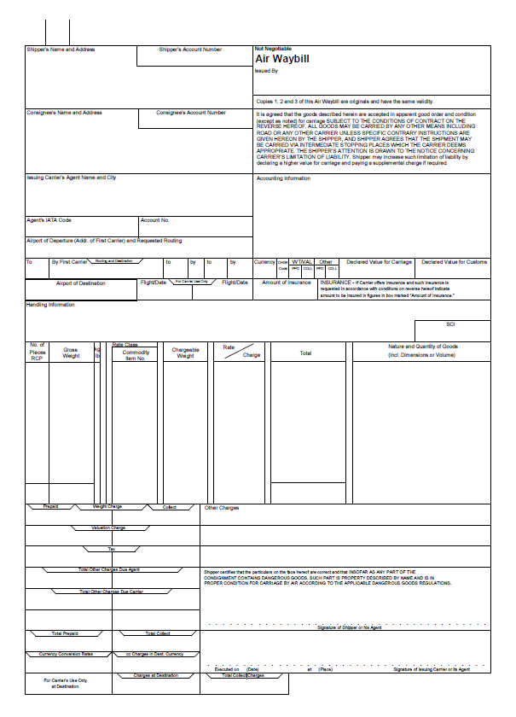
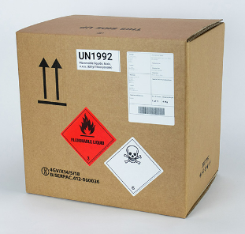
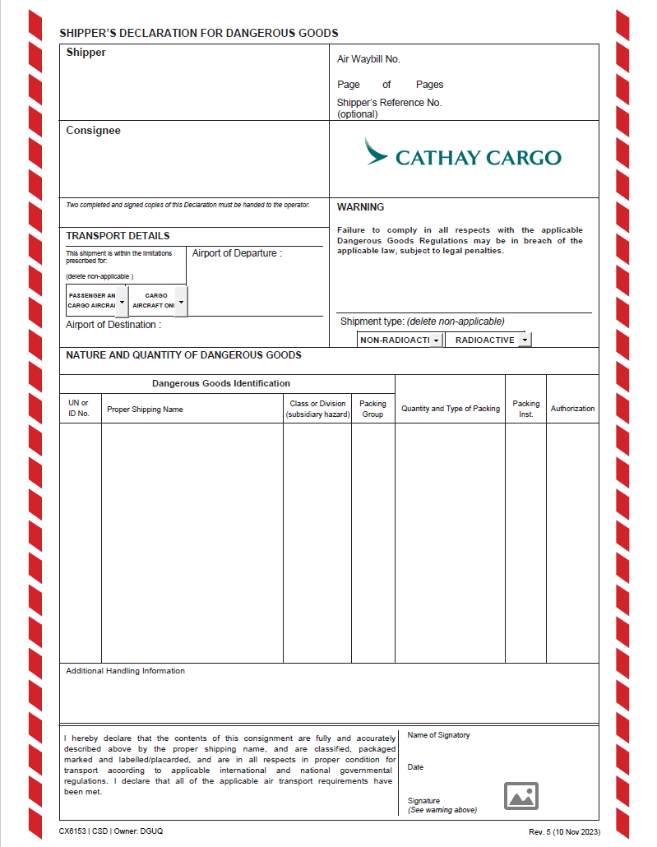
Elements Provided by Shipper In the Acceptance Check
Completed Shipper’s Declaration for Dangerous Goods (DGD)
Completed Air Waybill (AWB)
Dangerous Goods cargo(es)

Slide 12
Types of DG Shipments

Slide 13
Types of DG Shipments
Excepted Quantity
(REQ)
Or
Dry Ice Packed with non DG
Excepted
Lithium Battery
Non-Radioactive Shipment
Radioactive Shipment

Slide 14
Excepted Quantity (REQ)

Slide 15
Excepted Quantity
Shipment Information
UN Number | UN 2215
Proper Shipping Name | Maleic anhydride
Class | 8
Packing Group | III
EQ Code | E1
Max Net Quantity Per Outer Packaging | 1kg / 1L
Actual Net Quantity in Outer Packaging | 0.8kg

Slide 16


Excepted Quantity
Correct Package
Front:
Left:
Right:
SHIPPER
ABC Chemicals
1 Chun Wan Road
Chek Lap Kok
Hong Kong
CONSIGNEE
XYZ Pty LTD
3 Airport Road
Singapore
CATHAY PACIFIC
AWB No.
160 8800 8782
Destination Total No. of Pcs
SIN 1
Fast Cargo HK Ltd.
HAWB No. Origin
HKG-1234 HKG
Destination HAWB Pieces
SIN 1
8

Slide 17
Excepted Quantity
Incorrect Package
Front:
Left:
Right:
SHIPPER
ABC Chemicals
1 Chun Wan Road
Chek Lap Kok
Hong Kong
CONSIGNEE
XYZ Pty LTD
3 Airport Road
Singapore
CATHAY PACIFIC
AWB No.
160 8800 8782
Destination Total No. of Pcs
SIN 1
Fast Cargo HK Ltd.
HAWB No. Origin
HKG-1234 HKG
Destination HAWB Pieces
SIN 1
8

Slide 18
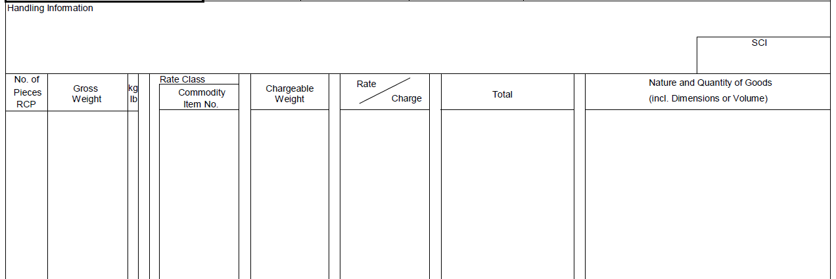
Excepted Quantity
Correct Air Waybill
1 1.5 K
Maleic anhydride
UN 2215
Dangerous Goods in Excepted Quantities

Slide 19
Excepted Quantity
Incorrect Air Waybill
1 1.5 K
Maleic anhydride
Dangerous Goods in Excepted Quantities

Slide 20
Dry Ice Packed With Non-DG

Slide 21
Dry Ice Packed with Non-DG
Shipment Information
UN Number |  | UN 1845
Proper Shipping Name |  | Dry ice Carbon dioxide, solid
Class |  | 9
Packing Group |  | /
Passenger & Cargo Aircraft | Packing Instruction | 954
 | Max Net Quantity Per Package | 200 kg
Cargo Aircraft Only | Packing Instruction | 954
 | Max Net Quantity Per Package | 200 kg
Actual Net Quantity in Package | 2 kg

Slide 22

Dry Ice Packed with Non-DG
Correct Package
Front:
Left:
Right:
SHIPPER
ABC Chemicals
1 Chun Wan Road
Chek Lap Kok
Hong Kong
CONSIGNEE
XYZ Pty LTD
3 Airport Road
Singapore
UN 1845
Dry Ice
Net Quantity 2kg
CATHAY PACIFIC
AWB No.
160 8800 8782
Destination Total No. of Pcs
SIN 1
Fast Cargo HK Ltd.
HAWB No. Origin
HKG-1234 HKG
Destination HAWB Pieces
SIN 1

Slide 23
Dry Ice Packed with Non-DG
Incorrect Package
Front:
Left:
Right:
SHIPPER
ABC Chemicals
1 Chun Wan Road
Chek Lap Kok
Hong Kong
CONSIGNEE
XYZ Pty LTD
3 Airport Road
Singapore
UN 1845
Dry Ice
CATHAY PACIFIC
AWB No.
160 8800 8782
Destination Total No. of Pcs
SIN 1
Fast Cargo HK Ltd.
HAWB No. Origin
HKG-1234 HKG
Destination HAWB Pieces
SIN 1

Slide 24
Dry Ice Packed with Non-DG
Correct Air Waybill
2 12.0 K
Frozen Meat
UN 1845
Dry ice
1 x 2 kg
Note: 2 packages under this Air Waybill, but only 1 package contains dry ice

Slide 25
Dry Ice Packed with Non-DG
Incorrect Air Waybill
2 12.0 K
Frozen Meat
UN 1845
Dry ice
Note: 2 packages under this Air Waybill, but only 1 package contains dry ice

Slide 26
Excepted Lithium Ion Battery (UN 3481)

Slide 27
Excepted Lithium Ion Battery (UN 3481)
Shipment Information
UN Number |  | UN 3481
Proper Shipping Name |  | Lithium Ion Batteries Packed with Equipment
Class |  | 9
Packing Group |  | /
Packing Instruction |  | 966 – Section II
Passenger aircraft | Net Quantity of Lithium Ion Cells or Batteries Per Package | 5 kg
Cargo aircraft | Net Quantity of Lithium Ion Cells or Batteries Per Package | 5 kg
Note: 2 PSNs for 1 UN number. Must provide actual shipment info to avoid confusion
Actual Net Quantity of Lithium Ion Batteries in Package | 3 kg

Slide 28

Excepted Lithium Ion Battery (UN 3481)
Correct Package
Front:
Left:
Right:
SHIPPER
ABC Chemicals
1 Chun Wan Road
Chek Lap Kok
Hong Kong
CONSIGNEE
XYZ Pty LTD
3 Airport Road
Singapore
CATHAY PACIFIC
AWB No.
160 8800 8782
Destination Total No. of Pcs
SIN 1
Fast Cargo HK Ltd.
HAWB No. Origin
HKG-1234 HKG
Destination HAWB Pieces
SIN 1
UN3481

Slide 29

Excepted Lithium Ion Battery (UN 3481)
Incorrect Package
Front:
Left:
Right:
SHIPPER
ABC Chemicals
1 Chun Wan Road
Chek Lap Kok
Hong Kong
CONSIGNEE
XYZ Pty LTD
3 Airport Road
Singapore
CATHAY PACIFIC
AWB No.
160 8800 8782
Destination Total No. of Pcs
SIN 1
Fast Cargo HK Ltd.
HAWB No. Origin
HKG-1234 HKG
Destination HAWB Pieces
SIN 1

Slide 30
Excepted Lithium Ion Battery (UN 3481)
Correct Air Waybill
Lithium ion batteries in compliance with Section II of PI 966

Slide 31
Excepted Lithium Ion Battery (UN 3481)
Incorrect Air Waybill
Lithium ion batteries packed with equipment in compliance with Section II of PI 966

Slide 32
Excepted Lithium Battery (UN 3091)

Slide 33
Excepted Lithium Battery (UN 3091)
Shipment Information
UN Number |  | UN 3091
Proper Shipping Name |  | Lithium Metal Batteries Packed with Equipment
Class |  | 9
Packing Group |  | /
Packing Instruction |  | 969 – Section II
Passenger aircraft | Net Quantity of Lithium Metal Cells or Batteries Per Package | 5 kg
Cargo aircraft | Net Quantity of Lithium Metal Cells or Batteries Per Package | 5 kg
Note: 2 PSNs for 1 UN number. Must provide actual shipment info to avoid confusion
Actual Net Quantity of Lithium Metal Batteries in Package | 1.5 kg

Slide 34
Excepted Lithium Battery (UN 3091)
Correct Package
Front:
Left:
Right:
SHIPPER
ABC Chemicals
1 Chun Wan Road
Chek Lap Kok
Hong Kong
CONSIGNEE
XYZ Pty LTD
3 Airport Road
Singapore
CATHAY PACIFIC
AWB No.
160 8800 8782
Destination Total No. of Pcs
SIN 1
Fast Cargo HK Ltd.
HAWB No. Origin
HKG-1234 HKG
Destination HAWB Pieces
SIN 1
UN3091

Slide 35
Excepted Lithium Battery (UN 3091)
Incorrect Package
Front:
Left:
Right:
SHIPPER
ABC Chemicals
1 Chun Wan Road
Chek Lap Kok
Hong Kong
CONSIGNEE
XYZ Pty LTD
3 Airport Road
Singapore
CATHAY PACIFIC
AWB No.
160 8800 8782
Destination Total No. of Pcs
SIN 1
Fast Cargo HK Ltd.
HAWB No. Origin
HKG-1234 HKG
Destination HAWB Pieces
SIN 1
UN3091

Slide 36
Excepted Lithium Battery (UN 3091)
Correct Air Waybill
Lithium metal batteries in compliance with Section II of PI 969

Slide 37
Excepted Lithium Battery (UN 3091)
Incorrect Air Waybill
Lithium metal batteries in compliance with PI 969

Slide 38
Non-Radioactive Dangerous Good

Slide 39
Non Radioactive
Shipment Information
UN Number |  |  | UN 2841
Proper Shipping Name |  |  | Di-n-amylamine
Class |  |  | 3 (6.1)
Packing Group |  |  | III
Passenger & Cargo Aircraft | Ltd Qty | Packing Instruction | Y 343
 |  | Max Net Quantity Per Package | 2 L
Passenger & Cargo Aircraft | Packing Instruction |  | 355
 | Max Net Quantity Per Package |  | 60 L
Cargo Aircraft Only | Packing Instruction |  | 366
 | Max Net Quantity Per Package |  | 220 L
Actual Net Quantity in Package | 5 L

Slide 40


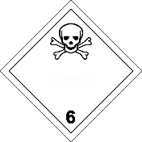

Non Radioactive
Correct Package
Front:
Left:
Right:
SHIPPER
ABC Chemicals
1 Chun Wan Road
Chek Lap Kok
Hong Kong
CONSIGNEE
XYZ Pty LTD
3 Airport Road
Singapore
UN 2841
Di-n-amylamine
CATHAY PACIFIC
AWB No.
160 8800 8782
Destination Total No. of Pcs
SIN 1
Fast Cargo HK Ltd.
HAWB No. Origin
HKG-1234 HKG
Destination HAWB Pieces
SIN 1
4G / Z30 / S / 22 GB / 667788

Slide 41
Non Radioactive
Incorrect Package
Front:
Left:
Right:
SHIPPER
ABC Chemicals
1 Chun Wan Road
Chek Lap Kok
Hong Kong
CONSIGNEE
XYZ Pty LTD
3 Airport Road
Singapore
UN 2841
Di-n-amylamine
CATHAY PACIFIC
AWB No.
160 8800 8782
Destination Total No. of Pcs
SIN 1
Fast Cargo HK Ltd.
HAWB No. Origin
HKG-1234 HKG
Destination HAWB Pieces
SIN 1
4D / Z30 / S / 22 GB / 667788

Slide 42
Non Radioactive
ABC Chemicals
1 Chun Wan Road
Chek Lap Kok
Hong Kong
160-88008782
1 1
XYZ Pty LTD
3 Airport Road
Singapore
Correct DGD
HONG KONG
XXXXX
SINGAPORE
XXXXXXXX
UN
2841
Di-n-amylamine
3 (6.1) III
1 Fibreboard x
5 L
355
24 Hour emergency contact: 852-27471111
Ming Lee
01 AUG 2024
Ming

Slide 43
Non Radioactive
ABC Chemicals
1 Chun Wan Road
Chek Lap Kok
Hong Kong
160-88008782
1 1
XYZ Pty LTD
3 Airport Road
Singapore
Incorrect DGD
HONG KONG
XXXXX
SINGAPORE
XXXXXXXX
UN
2841
Di-n-amylamine
3 III
1 Fibreboard x
5 L
355
24 Hour emergency contact: 852-27471111
Ming Lee
01 AUG 2024
Ming

Slide 44
Non Radioactive
Correct Air Waybill
Dangerous Goods as per associated DGD
Chemicals

Slide 45
Non Radioactive
Incorrect Air Waybill
Dangerous Goods as per DGD
Chemicals

Slide 46
Non-Radioactive (UN 3480 Sec. IB)

Slide 47
Non Radioactive (UN 3480 Sec. IB)
Shipment Information
UN Number |  | UN 3480
Proper Shipping Name |  | Lithium Ion Batteries
Class |  | 9
Packing Group |  | /
Packing Instruction |  | 965 – Section IB
Passenger aircraft | Net Quantity of Lithium Ion Cells or Batteries Per Package | Forbidden
Cargo aircraft | Net Quantity of Lithium Ion Cells or Batteries Per Package | 10 kg
Actual Net Quantity in Package | 8 kg

Slide 48

Non Radioactive (UN 3480 Sec. IB)
Correct Package
Front:
Left:
Right:
UN 3480
Lithium ion batteries
CATHAY PACIFIC
AWB No.
160 8800 8782
Destination Total No. of Pcs
SIN 1
Fast Cargo HK Ltd.
HAWB No. Origin
HKG-1234 HKG
Destination HAWB Pieces
SIN 1
SHIPPER
ABC Chemicals
1 Chun Wan Road
Chek Lap Kok
Hong Kong
CONSIGNEE
XYZ Pty LTD
3 Airport Road
Singapore
UN3480

Slide 49
Non Radioactive (UN 3480 Sec. IB)
Incorrect Package
Front:
Left:
Right:
UN 3480
Lithium ion batteries
CATHAY PACIFIC
AWB No.
160 8800 8782
Destination Total No. of Pcs
SIN 1
Fast Cargo HK Ltd.
HAWB No. Origin
HKG-1234 HKG
Destination HAWB Pieces
SIN 1
SHIPPER
ABC Chemicals
1 Chun Wan Road
Chek Lap Kok
Hong Kong
CONSIGNEE
XYZ Pty LTD
3 Airport Road
Singapore
UN3480

Slide 50
Non Radioactive (UN 3480 Sec. IB)
ABC Chemicals
1 Chun Wan Road
Chek Lap Kok
Hong Kong
160-88008782
1 1
XYZ Pty LTD
3 Airport Road
Singapore
Correct DGD
HONG KONG
XXXXX
SINGAPORE
XXXXXXXX
UN
3480
Lithium ion batteries
9
1 Fibreboard x
8 kg
965 IB
24 Hour emergency contact: 852-27471111
Ming Lee
01 AUG 2024
Ming

Slide 51
Non Radioactive (UN 3480 Sec. IB)
ABC Chemicals
1 Chun Wan Road
Chek Lap Kok
Hong Kong
160-88008782
1 1
XYZ Pty LTD
3 Airport Road
Singapore
Incorrect DGD
HONG KONG
XXXXX
SINGAPORE
XXXXXXXX
UN
3480
Lithium ion batteries
9
1 Fibreboard x
8 kg
965
24 Hour emergency contact: 852-27471111
Ming Lee
01 AUG 2024
Ming

Slide 52
Non Radioactive (UN 3480 Sec. IB)
Correct Air Waybill
Dangerous Goods as per associated Shipper’s Declaration – CAO
Lithium ion batteries

Slide 53
Non Radioactive (UN 3480 Sec. IB)
Incorrect Air Waybill
Dangerous Goods as per associated Shipper’s Declaration – CAO
Lithium ion batteries in compliance with Section IB of PI 965

Slide 54
Radioactive (Type A Package)

Slide 55
Radioactive (Type A Package)
Shipment Information
UN Number | UN 3332
Proper Shipping Name | Radioactive material, Type A package, Special Form
Class | 7
Radionuclide in Package | Lu-177, Special Form
Activity | 9.2 GBq
Transport Index | 0
Category | I-White
Gross Weight | 12 kg
Dimension | 38 x 22 x 32 cm

Slide 56
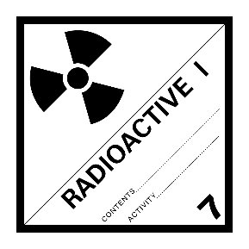
Radioactive (Type A Package)
Correct Package
Front:
Back:
Right and Left:
UN 3332
Radioactive material,
Type A package,
Special Form
TYPE A
F
RadMed Co
CATHAY PACIFIC
AWB No.
160 8800 8782
Destination Total No. of Pcs
HKG 1
Air Cargo Express
HAWB No. Origin
YYZ-1234 YYZ
Destination HAWB Pieces
HKG 1
Consignee
ABC Research Ltd.
12 Wan Po Road
Tseung Kwan O
Hong Kong
Lu-177
Lu-177
9.2 GBq
Shipper
XYZ Hospital
200 Front Street E
Toronto, Ontario
Canada M5J 2L7
9.2 GBq

Slide 57
Radioactive (Type A Package)
Incorrect Package
Front:
Back:
Right and Left:
UN 3332
Radioactive material,
Type A package,
Special Form
TYPE A
F
RadMed Co
CATHAY PACIFIC
AWB No.
160 8800 8782
Destination Total No. of Pcs
HKG 1
Air Cargo Express
HAWB No. Origin
YYZ-1234 YYZ
Destination HAWB Pieces
HKG 1
Consignee
ABC Research Ltd.
12 Wan Po Road
Tseung Kwan O
Hong Kong
Shipper
XYZ Hospital
200 Front Street E
Toronto, Ontario
Canada M5J 2L7
Lu-177
9.2 GBq

Slide 58
Radioactive (Type A Package)
XYZ Hospital
200 Front Street E
Toronto, Ontario
Canada M5J 2L7
160-88008782
1 1
ABC Research Ltd.
12 Wan Po Road
Tseung Kwan O
Hong Kong
Correct DGD
TORONTO
XXXXX
HONG KONG
XXXXXXXX
UN
3332
Radioactive material, Type A package,
Special Form
7
Lu-177
1 Type A Package x
9.2 GBq
Special Form Certificate
CA/123/S
Attached
I-
White
24 Hour emergency contact: +1 905-600-0000
Tom Green
01 AUG 2024
Tom

Slide 59
Radioactive (Type A Package)
XYZ Hospital
200 Front Street E
Toronto, Ontario
Canada M5J 2L7
160-88008782
1 1
ABC Research Ltd.
12 Wan Po Road
Tseung Kwan O
Hong Kong
Incorrect DGD
TORONTO
XXXXX
HONG KONG
XXXXXXXX
UN
3332
Radioactive material, Type A package,
Special Form
7
Lu-177
1 Type A Package x
9.2 GBq
I-
White
24 Hour emergency contact: +1 905-600-0000
Tom Green
01 AUG 2024
Tom

Slide 60
Radioactive (Type A Package)
Correct Air Waybill
Dangerous Goods as per associated Shipper’s Declaration
Radioactive material

Slide 61
Radioactive (Type A Package)
Incorrect Air Waybill
Dangerous Goods as per associated Declaration
Radioactive material

Slide 62
Case 4B – Radioactive (Type B(U) Package)

Slide 63
Radioactive (Type B(U) Package)
Shipment Information
UN Number | UN 2916
Proper Shipping Name | Radioactive material, Type B(U) package
Class | 7
Radionuclide in Package | I-123, solid
Activity | 7.4 MBq
Transport Index | 0.2
Category | III-Yellow
Gross Weight | 55 kg
Dimension | 50 x 50 x 55 cm

Slide 64
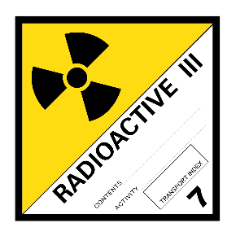

Radioactive (Type B(U) Package)
Correct Package (cylinder)
Front:
Back:
UN 2916
Radioactive material, Type B(U) Package
TYPE B(U)
US/24/BU
S/N#001
I-123
7.4 MBq
0.2
I-123
7.4 MBq
0.2
Shipper
ABC Research Ltd.
100 Harbor Blvd
Los Angeles CA
92626 USA
Consignee
MMM Hospital
1 Soi Phetchaburi
Bangkok 10310
Thailand
Permissible Gross Weight 55 kg

Slide 65
Radioactive (Type B(U) Package)
Incorrect Package (cylinder)
Front:
Back:
UN 2916
Radioactive material, Type B(U) Package
TYPE B(U)
US/24/BU
S/N#001
I-123
7.4 MBq
0.2
I-123
7.4 MBq
0.2
Shipper
ABC Research Ltd.
100 Harbor Blvd
Los Angeles CA
92626 USA
Consignee
MMM Hospital
1 Soi Phetchaburi
Bangkok 10310
Thailand

Slide 66
Radioactive (Type B(U) Package)
ABC Research Ltd.
100 Harbor Blvd
Los Angeles CA
92626 USA
160-88008782
1 1
MMM Hospital
1 Soi Phetchaburi
Bangkok 10310
Thailand
Correct DGD
LOS ANGELES
XXXXX
BANGKOK
XXXXXXXX
UN
2916
Radioactive material, Type B(U) package
7
I-123
Solid
1 Type B(U) Package x
7.4 MBq
Type B(U) Package Certificate
US/24/BU
Attached
II-
Yellow
T.I.
0.2
DIM:
50x
50x
55 cm
24 Hour emergency contact: +1 310-400-4000
Tom Green
01 AUG 2024
Tom

Slide 67
Radioactive (Type B(U) Package)
ABC Research Ltd.
100 Harbor Blvd
Los Angeles CA
92626 USA
160-88008782
1 1
MMM Hospital
1 Soi Phetchaburi
Bangkok 10310
Thailand
Incorrect DGD
LOS ANGELES
XXXXX
BANGKOK
XXXXXXXX
UN
2916
Radioactive material, Type B(U) package
7
I-123
1 Type B(U) Package x
7.4 MBq
Type B(U) Package Certificate
US/24/BU
Attached
II-
Yellow
T.I.
0.2
DIM:
50x
50x
55 cm
24 Hour emergency contact: +1 310-400-4000
Tom Green
01 AUG 2024
Tom

Slide 68
Radioactive (Type B(U) Package)
Correct Air Waybill
Dangerous Goods as per associated DGD – CAO
Radioactive material

Slide 69
Radioactive (Type B(U) Package)
Incorrect Air Waybill
Dangerous Goods as per associated DGD
Radioactive material

